Slide 1
PS01CMCA52
COMPUTER NETWORKS.

Slide 2
GUIDED AND UNGUIDED TRANSMISSION MEDIA
Transmission media is the way the systems are connected to route data signals in a network.
They are also called wired or wireless transmission media.
Guided media are also called wired transmission media as they use wires for transmission from source to destination.

Slide 3
Unguided media are also called wireless transmission media as they use satellite and other sources for transmission of media from source to destination.
The transmission media are classified into two categories −
Guided media (wired)
Unguided media (wireless).

Slide 4
SR NO. | Guided Media | Unguided Media
1. | The guided media is also called wired communication | The unguided media is also called wireless communication
2. | Guided media is used for point-to-point communication. | Unguided media is generally suited for broadcasting in all directions.
3. | The signal energy propagates through wires in guided media. | The signal energy propagates through the air in unguided media.

Slide 5
SR NO. | Guided Media | Unguided Media
4. | Examples are : twisted pair wires, coaxial cables and optical fiber cables . | Examples are : microwave , radio links or satellite.
5. | For shorter distance this is best option. | For larger distance this method is used.
6. | It is unable to pass through walls. | It can pass through walls.

Slide 6
SR NO. | Guided Media | Unguided Media
7. | There is a fix direction in which signal travels. | There is no fix direction for signal to travel.
8. | Signals are in form of voltage or current in guided media. | Signals are in form of electromagnetic waves in unguided media.
9. | Less signal loss over longer distance. | Greater signal loss over longer range.

Slide 7
SR NO. | Guided Media | Unguided Media
10. | Limited flexibility and mobility due to wire constraints. | Offers mobility and flexibility.
11. | capable of high speed data transmission. | Speed for data transmission might be slower than guided media.
12. | Offers high reliability in data transmission. | Reliability can be affected by environmental factors.

Slide 8
SR NO. | Guided Media | Unguided Media
13. | No line of sight required between devices.. | Requires a clear line of sight for some applications.
14. | Telephone lines, internet connections, and cable TV. | Wireless internet, Bluetooth, and remote controls.
15. | Generally more complex to install due to cables. | Simpler installation but may require more devices.

Slide 9
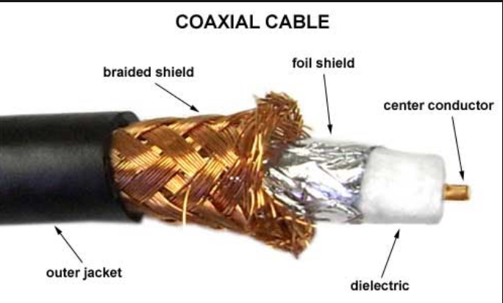
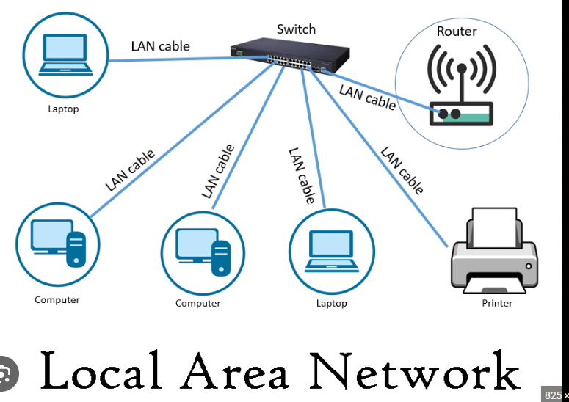
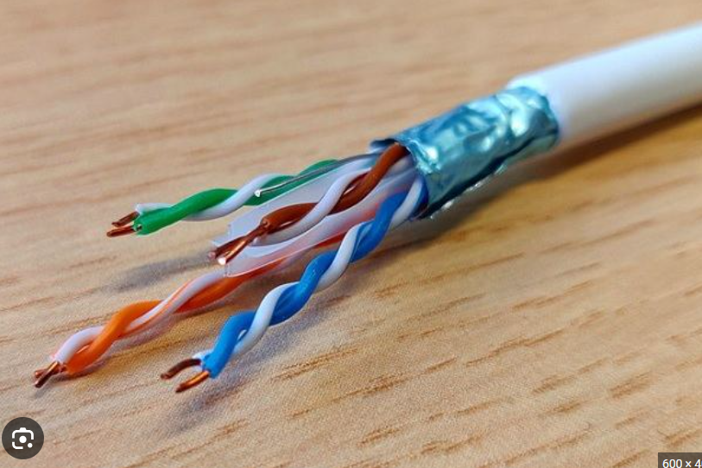
GUIDED MEDIA EXAMPLE

Slide 10
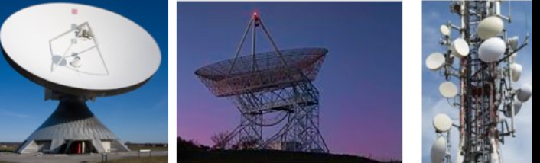
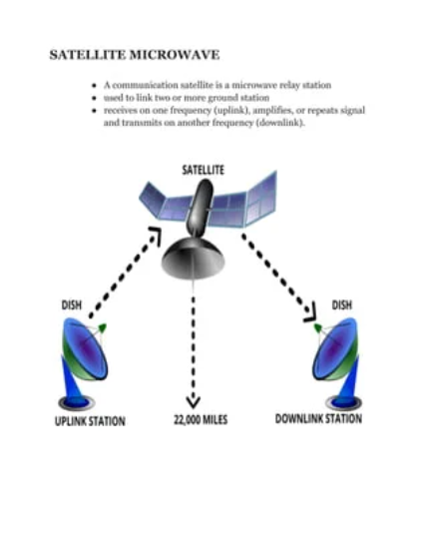
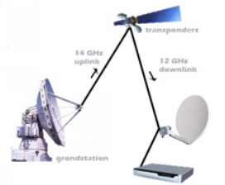
UNGUIDED MEDIA EXAMPLE

Slide 11
THANK YOU….

